Slide 1
COMPUTER ORGANIZATION & ARCHITECTURE

Slide 2
COURSE STRUCTURE (MR22-1CS0142)
UNIT-1
Digital Components: Integrated Circuits, Decoders, Multiplexers, Registers, Shift Registers, Binary Counters, Memory Unit.
Data Representation: Data Types, Complements, Fixed-Point Representation, Conversion of Fractions, Floating-Point Representation, Other Binary Codes, Error Detection Codes.
UNIT-2
Register Transfer and Microoperations: Register Transfer Language, Register Transfer, Bus and Memory Transfers, Arithmetic Microoperations, Logic Microoperations, Shift Microoperations, Arithmetic Logic Shift Unit.
UNIT-3
Basic Computer Organization and Design: Instruction Codes, Computer Registers, Computer Instructions, Timing and Control, Instruction Cycle, Memory-Reference Instructions, Input-Output and Interrupt, Complete Computer Description, Design of Basic Computer, Design of Accumulator Logic.

Slide 3
COURSE STRUCTURE (MR22-1CS0142)
UNIT-4
Central Processing Unit: Introduction, General Register Organization, Stack Organization, Instruction Formats, Addressing Modes, Data Transfer and Manipulation, Program Control, Reduced Instruction Set Computer(RISC)
UNIT-5
Input-Output Organization: Peripheral Devices, Input-Output Interface, Asynchronous Data Transfer, Modes of Transfer, Priority Interrupt, Direct Memory Access (DMA), Input- Output Processor (IOP), Serial Communication, Bus Standards.

Slide 4
Digital Components
Unit-1
Data Representation

Slide 5
Digital Components
» Integrated Circuits
» Decoders
» Multiplexers
» Registers
» Shift Registers
» Binary Counters
» Memory Unit

Slide 6
Integrated Circuits
Digital circuits are constructed with integrated circuits. An integrated circuit (abbreviated IC) is a small silicon semiconductor crystal called a chip, containing the electronic components for the digital gates.
The various gates are interconnected inside the chip to form the required circuit
The chip is mounted in a ceramic or plastic container, and connections are welded by thin gold wires to external pins to form the integrated circuit.
The number of pins may range from 14 in a small IC package to 100 or more in a larger package. Each IC has a numeric designation printed on the surface of the package for identification.

Slide 7
Integrated Circuits
Scale of Integration or Classification of integrated circuits
Small-scale integration (SSI): devices contain several independent gates in a single package. The inputs and outputs of the gates are connected directly to the pins in the package. The number of gates is usually less than 10 and is limited by the number of pins available in the IC.
Medium-scale integration (MSI): devices have a complexity of approximately 10 to 200 gates in a single package. They usually perform specific elementary digital functions such as decoders, adders, and registers.
Large-scale integration (LSI): devices contain between 200 and a few thousand gates in a single package. They include digital systems, such as processors, memory chips, and programmable modules.
Very-large-scale integration (VLSI): devices contain thousands of gates within a single package. Examples are large memory arrays and complex microcomputer chips.
Super large scale integration (SLSI): devices contain between 10,000 and 1,00,000 gates within a single package and perform computational operations such as microprocessor chips, micro-controllers, basic PICs (Peripheral Interface Controller) and calculator.

Slide 8
Integrated Circuits
Ultra large scale integration (ULSI): devices contain More than 1 million gates and it is used in computers CPUs, GPUs, Video processors.
Logic Families:
The IC technology usually depends on the following factors:
1) Speed.
2) Power description.
3) Noise immunity.
4) Input/output interface compatibility.
5) Cost.
Digital Integrated Circuits:
The advantages if ICs being used in digital systems are
1) Small size.
2) High reliability.
3) Low cost.
4) Low power consumption.

Slide 9
Integrated Circuits
There are two broad categories of digital ICs. They are
Fixed function logic
Programmable logic
Fixed function logic: The logic function of IC are set by the manufacturer and cannot be altered.
Programmable logic: The logic function of IC can be altered.
The two basic techniques for manufacturing ICs are
Bipolar techniques
Metal Oxide Semiconductor (MOS) techniques

Slide 10
Integrated Circuits
Classification of digital ICs families are
1. Bipolar techniques
> Resistor transistor logic (RTL)
> Diode transistor logic (DTL)
> Transistor transistor logic (TTL)
> Emitter coupled logic (ECL)
2. Metal Oxide Semiconductor techniques
> P channel MOSFET (PMOS)
> N channel MOSFET (NMOS)
> Complementary MOSFET (CMOS)

Slide 11
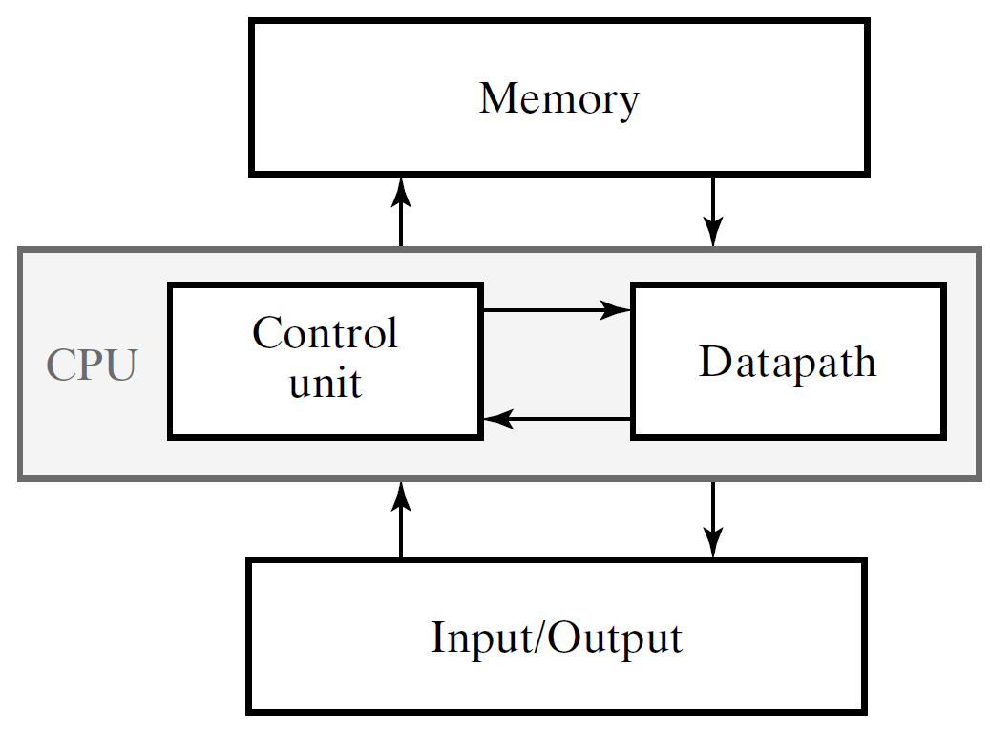
Basics
Block Diagram of a Digital Computer

Slide 12
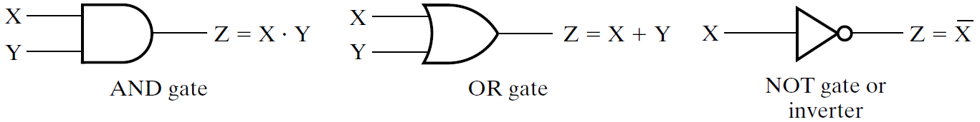
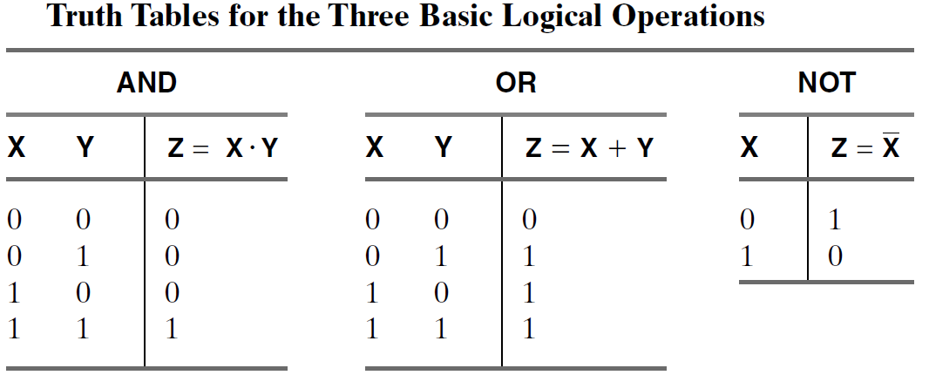
Basics

Slide 13
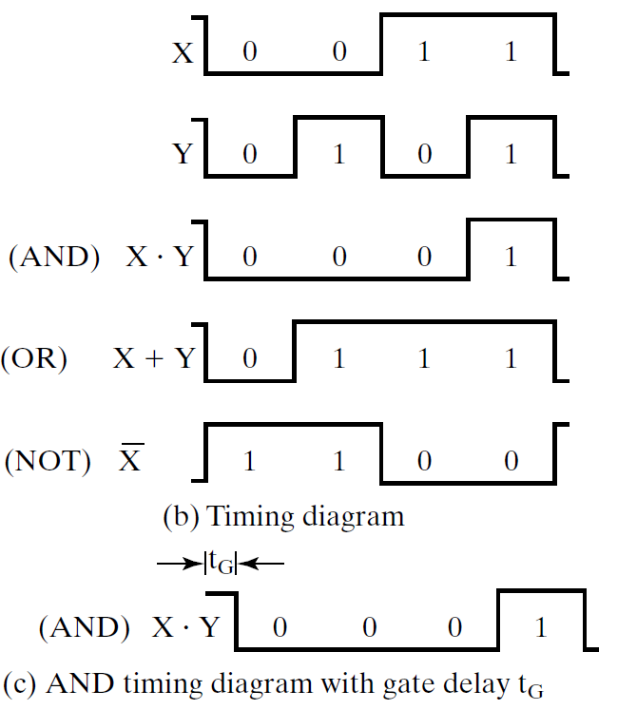
Basics
Digital Logic Gates
X | Y
0 | 0
0 | 1
1 | 0
1 | 1

Slide 14
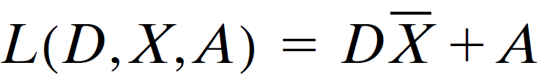
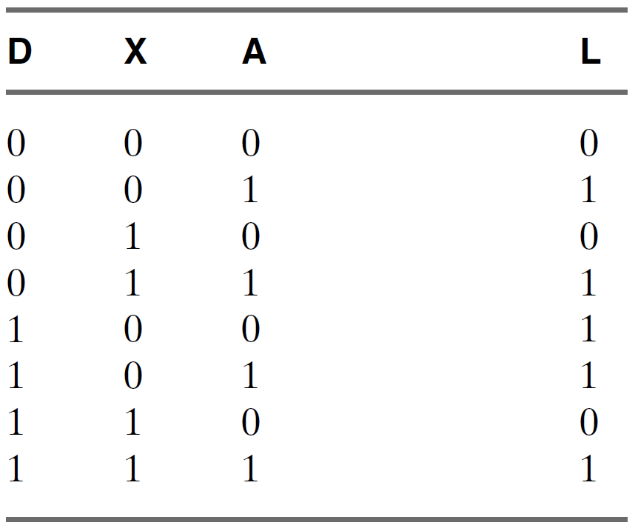
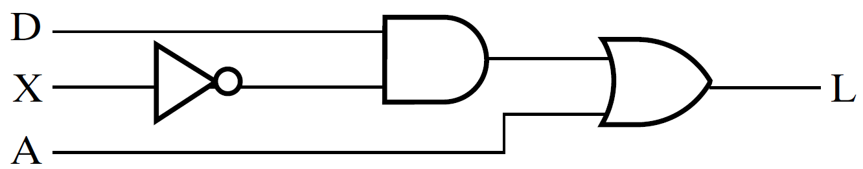
Basics
Example-1
Consider an example Boolean equation representing electrical or electronic logic for control of the lowering of the driver’s power window in a car.
Truth Table
Truth Table Logic Circuit Diagram

Slide 15
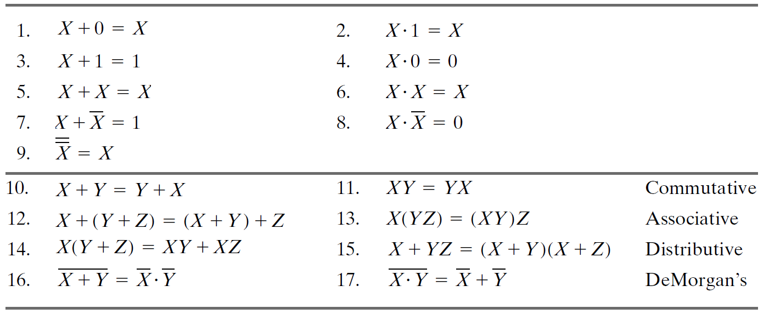
Basics
Basic Identities of Boolean Algebra

Slide 16
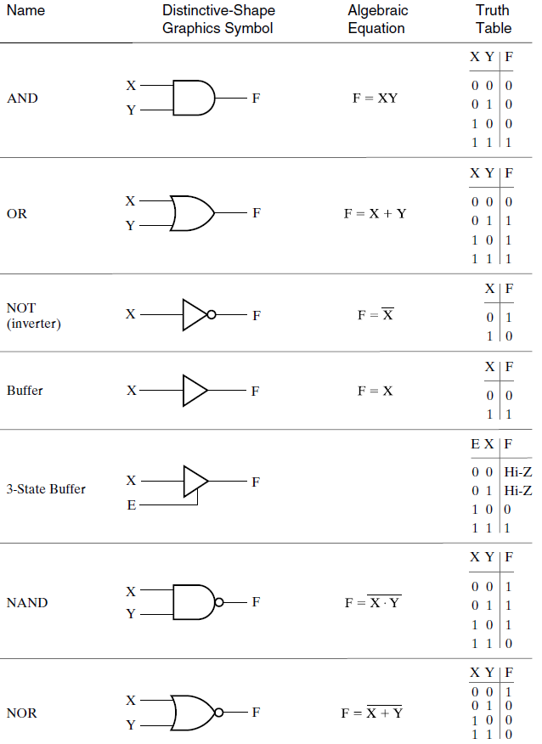
Primitive Digital Logic Gates
AND
OR
NOT
NAND
NOR
BUFFER

Slide 17
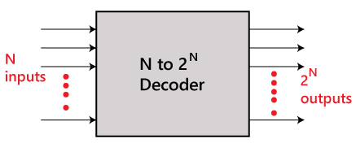
DECODERS
A decoder is a combinational circuit that converts binary information from the n coded inputs to a maximum of 2 unique outputs.
A decoder has n inputs and m outputs and is also referred to as an n x m decoder
n input lines
2^{n} Output lines
n x 2^{n}
If n = 2 ; 2 x 4 decoder or 2 to 4 line decoder
If n = 3 ; 3 x 8 decoder or 3 to 8 line decoder
If n = 4 ; 4 x 16 decoder or 4 to 16 line decoder
If n = 5 ; 5 x 32 decoder or 5 to 32 line decoder

Slide 18
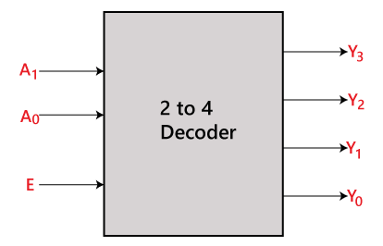
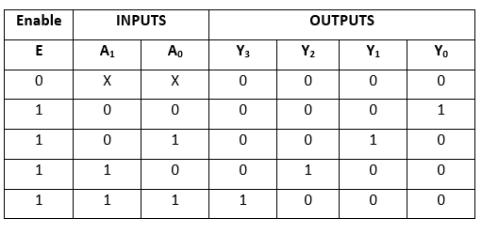
2 to 4 line decoder
DECODERS
Block Diagram
TRUTH TABLE
Logical expression
Y₃ = E.A₁.A₀ Y₂ = E.A₁.A₀’ Y₁ = E.A₁’.A₀ Y₀ = E.A₁'.A₀'

Slide 19
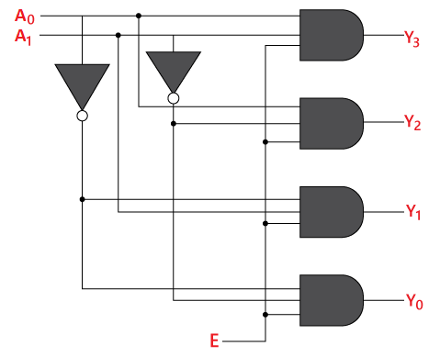
DECODERS
Logical circuit

Slide 20
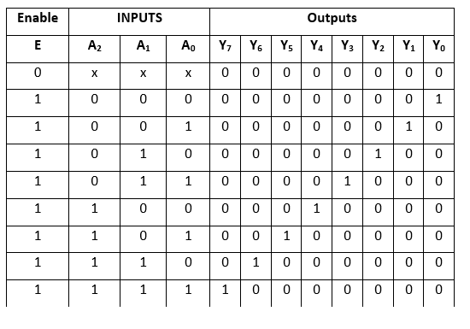
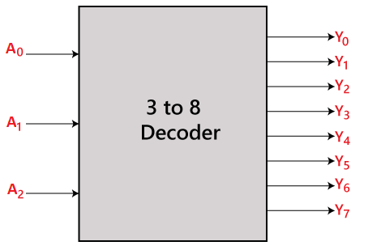
3 to 8 line decoder
DECODERS
Truth Table
Block Diagram
Y₀=A₀'.A₁'.A₂’ Y₁=A₀.A₁'.A₂' Y₂=A₀'.A₁.A₂’ Y₃=A₀.A₁.A₂’
Y₄=A₀'.A₁’.A₂ Y₅=A₀.A₁'.A₂ Y₆=A₀'.A₁.A₂ Y₇=A₀.A₁.A₂
Logical expression

Slide 21
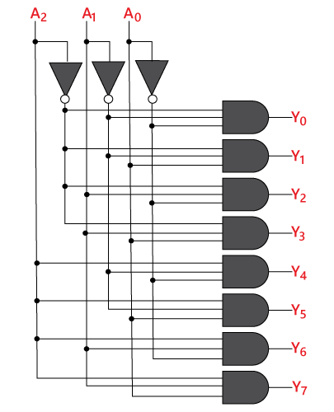
DECODERS
Logical circuit

Slide 22
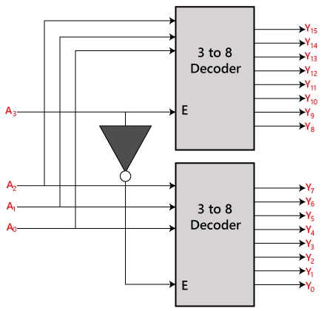
4 to 16 line decoder using two 3 to 8 line decoder
DECODERS
Block Diagram

Slide 23
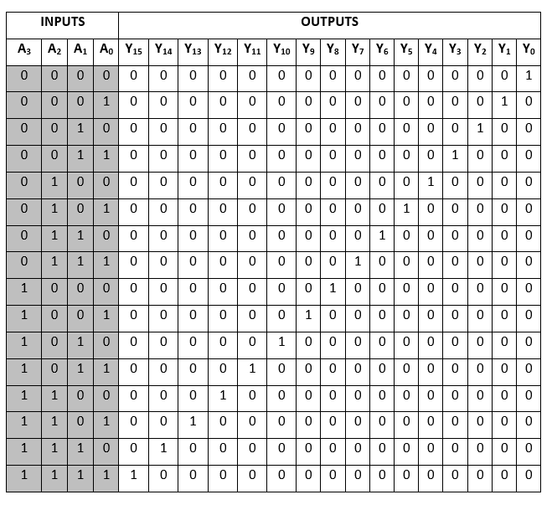
Y₀=A₀'.A₁'.A₂'.A₃' Y₁=A₀'.A₁'.A₂'.A₃ Y₂=A₀'.A₁'.A₂.A₃' Y₃=A₀'.A₁'.A₂.A₃ Y₄=A₀'.A₁.A₂'.A₃' Y₅=A₀'.A₁.A₂'.A₃ Y₆=A₀'.A₁.A₂.A₃' Y₇=A₀'.A₁.A₂.A₃ Y₈=A₀.A₁'.A₂'.A₃' Y₉=A₀.A₁'.A₂'.A₃ Y₁₀=A₀.A₁'.A₂.A₃' Y₁₁=A₀.A₁'.A₂.A₃ Y₁₂=A₀.A₁.A₂'.A₃' Y₁₃=A₀.A₁.A₂'.A₃ Y₁₄=A₀.A₁.A₂.A₃' Y₁₅=A₀.A₁.A₂'.A₃
Truth Table
DECODERS
Logical expression

Slide 24
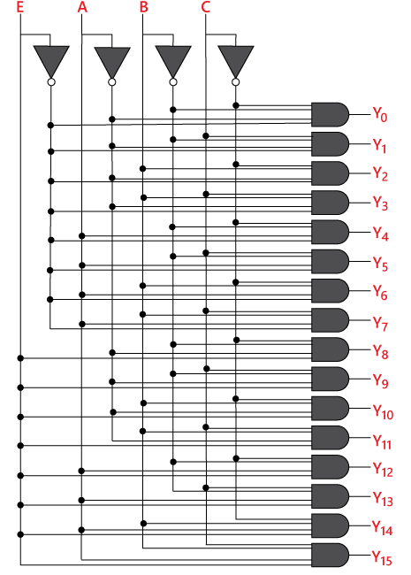
Logical circuit
DECODERS

Slide 25
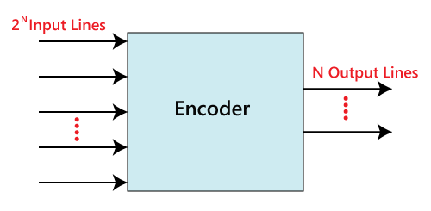
Encoders
Encoder performs the reverse operation of the Decoder
n output lines
2^{n} input lines
If n = 2 ; 4 x 2 encoder or 4 to 2 line encoder
If n = 3 ; 8 x 3 encoder or 8 to 3 line encoder
If n = 4 ; 16 x 4 encoder or 16 to 4 line encoder
If n = 5 ; 32 x 5 encoder or 32 to 5 line encoder
n x 2^{n}

Slide 26
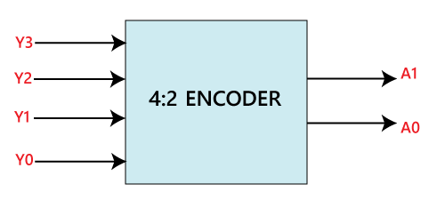
Encoders
4 to 2 line Encoder
Block Diagram

Slide 27
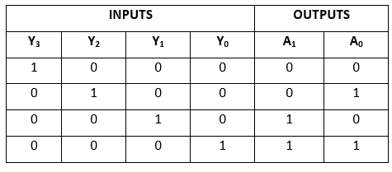
Encoders
Truth Table
Logical expression
A₁=Y₃+Y₂
A₀=Y₃+Y₁

Slide 28
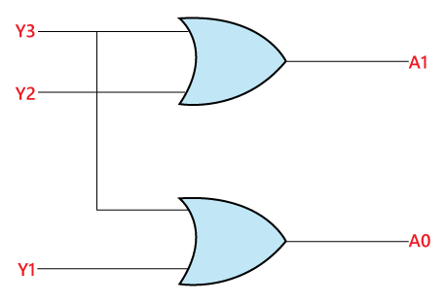
Encoders
Logical circuit

Slide 29
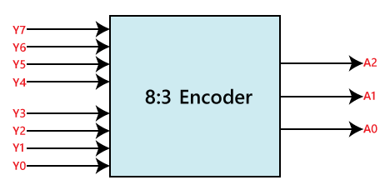
Encoders
8 to 3 line Encoder
Block Diagram

Slide 30
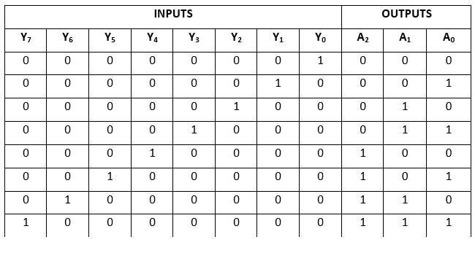
Encoders
Truth Table
A₂=Y₄+Y₅+Y₆+Y₇
A₁=Y₂+Y₃+Y₆+Y₇
A₀=Y₇+Y₅+Y₃+Y₁
Logical expression

Slide 31
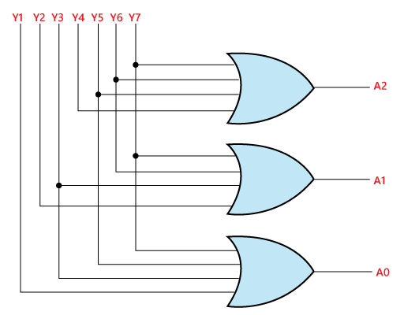
Encoders
Logical circuit

Slide 32
Multiplexers
A multiplexer is a combinational circuit that has 2^{n} input lines and a single output line.
A De-multiplexer is a combinational circuit that has only 1 input line and 2^{N} output lines.
Multiplexer
De-Multiplexer
2×1 Multiplexer
4×1 Multiplexer
8×1 Multiplexer
16×1 Multiplexer
1×2 De-multiplexer
1×4 De-multiplexer
1×8 De-multiplexer
1×16 De-multiplexer

Slide 33
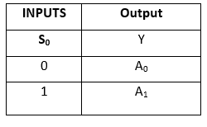
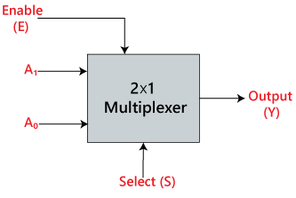
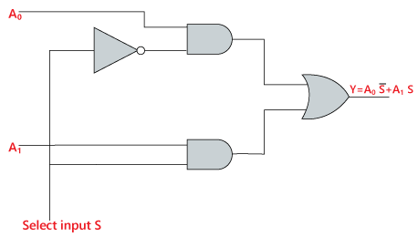
Multiplexers
2×1 Multiplexer
Truth Table
Logical expression
Block Diagram
Y= S₀'.A₀+S₀.A₁
Logical circuit

Slide 34
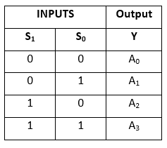
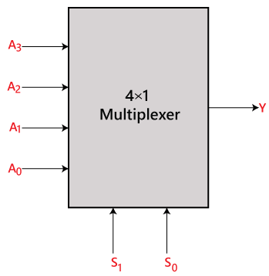
Multiplexers
4×1 Multiplexer
Truth Table
Block Diagram
Logical expression
Y=S₁' S₀' A₀+S₁' S₀ A₁+S₁ S₀' A₂+S₁ S₀ A₃

Slide 35
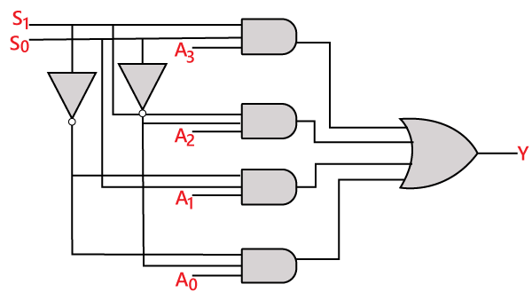
Multiplexers
Logical circuit

Slide 36
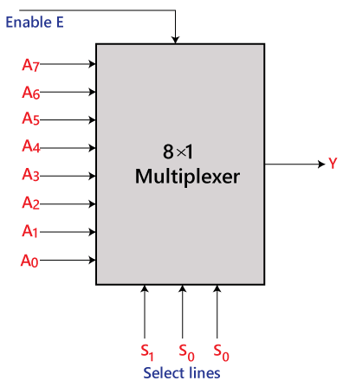
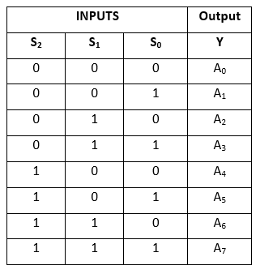
Multiplexers
8 to 1 Multiplexer
Truth Table
Block Diagram

Slide 37
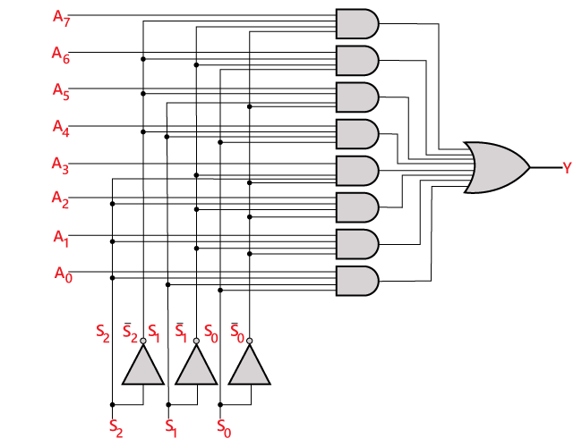
Multiplexers
Logical expression
Y=S₀'.S₁'.S₂’.A₀ + S₀.S₁'.S₂'.A₁+
S₀'.S₁.S₂’.A₂ + S₀.S₁.S₂'.A₃+
S₀'.S₁'.S₂ A₄ + S₀.S₁'.S₂ A₅+
S₀'.S₁.S₂ .A₆ + S₀.S₁.S₃.A₇
Logical circuit

Slide 38
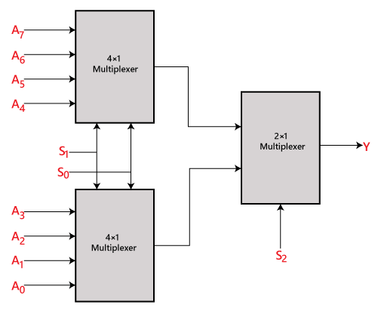
Multiplexers
8 ×1 multiplexer using 4×1 and 2×1 multiplexer
Block Diagram

Slide 39
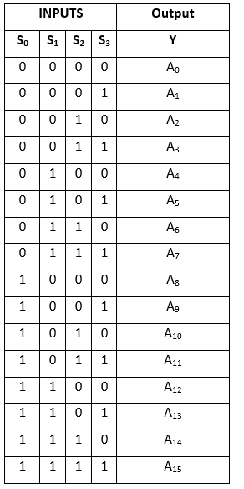
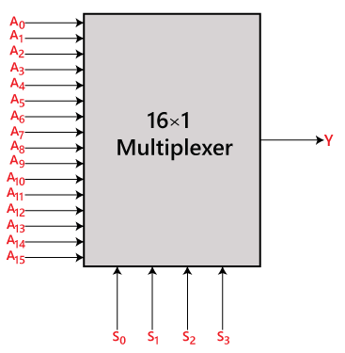
Y=A₀.S₀'.S₁'.S₂'.S₃’+
A₁.S₀'.S₁'.S₂ '.S₃+
A₂.S₀'.S₁'.S₂.S₃’+
A₃.S₀'.S₁ '.S₂.S₃+
A₄.S₀'.S₁.S₂'.S₃’+
A₅.S₀ '.S₁.S₂'.S₃+
A₆.S₁.S₂.S₃’+
A₇.S₀ '.S₁.S₂.S₃+
A₈.S₀.S₁'.S₂'.S₃’+
A₉ .S₀.S₁'.S₂'.S₃+
A₁₀.S₀.S₁'.S₂.S₃ ’+
A₁₁.S₀.S₁'.S₂.S₃+
A₁₂ S₀.S₁.S₂ '.S₃’+
A₁₃.S₀.S₁.S₂'.S₃+
A₁₄.S₀.S₁ .S₂.S₃’+
A₁₅.S₀.S₁.S₂'.S₃
Multiplexers
16 to 1 Multiplexer

Slide 40
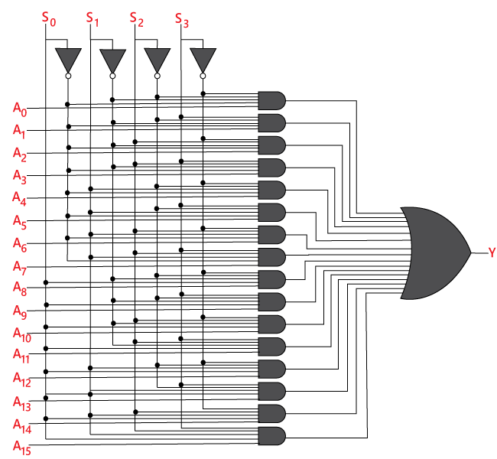
Multiplexers
Logical circuit

Slide 41
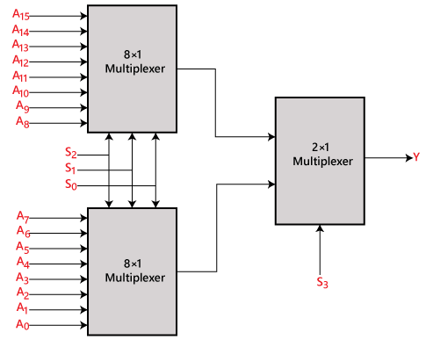
Multiplexers
16×1 multiplexer using 8×1 and 2×1 multiplexer
Block Diagram

Slide 42
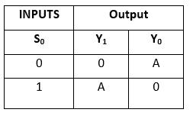
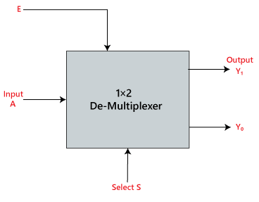
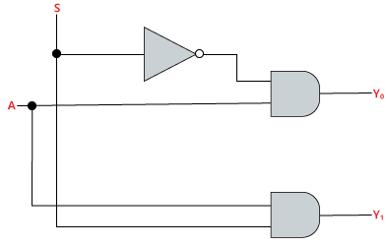
De-Multiplexers
A De-multiplexer is a combinational circuit that has only 1 input line and 2^{N} output lines. Simply, the multiplexer is a single-input and multi-output combinational circuit.
1×2 De-multiplexer
Truth Table
Logical expression
Block Diagram
Y₀=S₀’.A
Y₁=S₀.A
Logical circuit

Slide 43
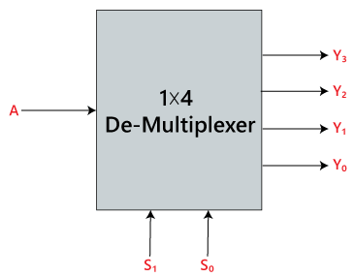
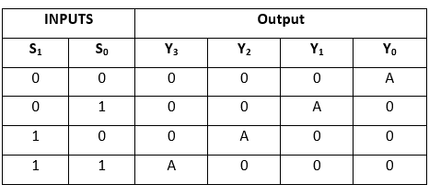
De-Multiplexers
1×4 De-multiplexer
Block Diagram
Truth Table
Y₀=S₁' S₀' A y₁=S₁' S₀ A y₂=S₁ S₀' A y₃=S₁ S₀ A
Logical expression

Slide 44
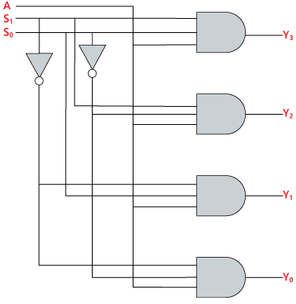
De-Multiplexers
Logical circuit

Slide 45
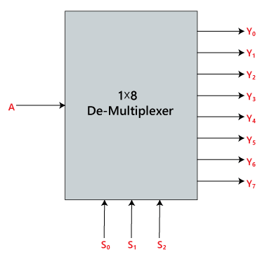
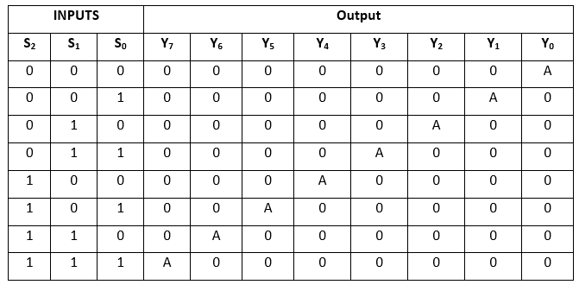
De-Multiplexers
1×8 De-multiplexer
Block Diagram
Truth Table
Logical expression
Y₀=S₀'.S₁'.S₂'.A Y₁=S₀.S₁'.S₂'.A
Y₂=S₀'.S₁.S₂'.A Y₃=S₀.S₁.S₂'.A
Y₄=S₀'.S₁'.S₂ A Y₅=S₀.S₁'.S₂ A
Y₆=S₀'.S₁.S₂ A Y₇=S₀.S₁.S₃.A

Slide 46
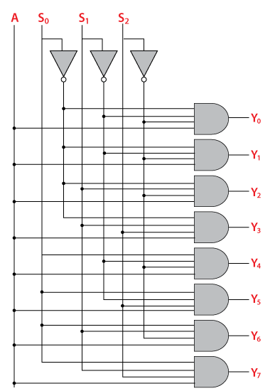
De-Multiplexers
Logical circuit
Logical expression
Y₀=S₀'.S₁'.S₂'.A
Y₁=S₀.S₁'.S₂'.A
Y₂=S₀'.S₁.S₂'.A
Y₃=S₀.S₁.S₂'.A
Y₄=S₀'.S₁'.S₂ A
Y₅=S₀.S₁'.S₂ A
Y₆=S₀'.S₁.S₂ A
Y₇=S₀.S₁.S₃.A

Slide 47
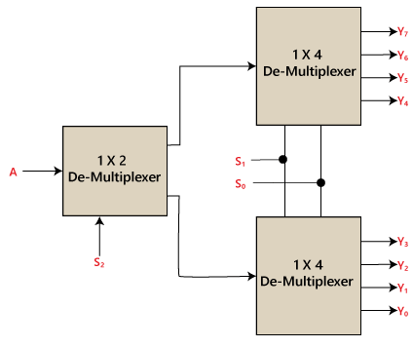
De-Multiplexers
1×8 De-multiplexer using 1×4 and 1×2 de-multiplexer
Block Diagram

Slide 48

De-Multiplexers
1 x 16 De-multiplexer
Block Diagram

Slide 49

De-Multiplexers
Truth Table
Logical expression
Y₀=A.S₀'.S₁'.S₂'.S₃' Y₁=A.S₀'.S₁'.S₂'.S₃ Y₂=A.S₀'.S₁'.S₂.S₃' Y₃=A.S₀'.S₁'.S₂.S₃ Y₄=A.S₀'.S₁.S₂'.S₃' Y₅=A.S₀'.S₁.S₂'.S₃ Y₆=A.S₀'.S₁.S₂.S₃' Y₇=A.S₀'.S₁.S₂.S₃ Y₈=A.S₀.S₁'.S₂'.S₃' Y₉=A.S₀.S₁'.S₂'.S₃ Y₁₀=A.S₀.S₁'.S₂.S₃' Y₁₁=A.S₀.S₁'.S₂.S₃ Y₁₂=A.S₀.S₁.S₂'.S₃' Y₁₃=A.S₀.S₁.S₂'.S₃ Y₁₄=A.S₀.S₁.S₂.S₃' Y₁₅=A.S₀.S₁.S₂'.S₃

Slide 50

De-Multiplexers
Logical circuit

Slide 51




Flip-Flops
A flip-flop is a digital memory circuit that stores “one bit” of data.
Flip-flops are the primary blocks of the most sequential circuits. It is also called one-bit memory or binary. They acts as a memory elements in a sequential circuit.
SR (Set-Reset) Flip-Flop
JK Flip-Flop
Data or Delay (D) Flip-Flop
Toggle (T) Flip-Flop
SR
D
JK
T

Slide 52

Registers
A register is a group of flip-flops with each flip-flop capable of storing one bit of information.
An n-bit register has a group of n flip-flops and is capable of storing any binary information of n bits.

Slide 53
Registers
Data can be entered in serial or parallel form.
Serial form means one bit at a time,
while parallel form means all bits at a time.
The data can be entered and extracted in either serial or parallel form.
Classification of Registers
(Depending on the input and Output)
1) Serial Input Serial Output (SISO)
2) Serial Input Parallel Output (SIPO)
3) Parallel Input Serial Output (PISO)
4) Parallel Input Parallel Output (PIPO)
Classification of Registers
(Depending on the Application)
1) Shift Registers
2) Storage Register

Slide 54




Serial Input, Serial Output Shift Register
Registers

Slide 55
Registers
Data at “data in” will be present at the Stage A output after the first clock pulse.
After the second pulse, stage A data is transferred to stage B output, and “data in” is transferred to stage A output.
After the third clock, stage C is replaced by stage B; stage B is replaced by stage A; and stage A is replaced by “data in”.
After the fourth clock, the data originally present at “data in” is at stage D, “output”. The “first in” data is “first out” as it is shifted from “data in” to “data out”.

Slide 56

Registers
Parallel-In, Serial-Out Shift Register
In stage D data will be present at the “data out” up until the first clock pulse.
Stage C data will be present at “data out” between the first clock and the second clock pulse.
Stage B data will be present between the second clock and the third clock.
Stage A data will be present between the third and the fourth clock.

Slide 57

Registers
Serial-In, Parallel-Out Shift Register
After the first clock, the data at “data in” appears at QA.
After the second clock, the old QA data appears at QB; QA receives the next data from “data in”.
After the third clock, QB data is at QC.
After the fourth clock, QC data is at QD. This stage contains the data first present at “data in”. The shift register now contains four data bits.

Slide 58

Registers
Parallel-In, Parallel-Out Shift Register
Applications: Storage Register or Buffer Register

Slide 59

Shift Registers
Bidirectional shift register with parallel load

Slide 60

A register that goes through a predetermined sequence of states upon the application of input pulses is called a counter.
The input pulses may be clock pulses or may originate from an external source. They may occur at uniform intervals of time or at random.
Counters are found in almost all equipment containing digital logic. They are used for counting the number of occurrences of an event and are useful for generating timing signals to control the sequence of operations in digital computers.
A counter circuit will usually employ flip-flops with complementing capabilities. Both Tand JK flip-flops have this property. Remember that a JK flip-flop is complemented if both its J and K inputs are 1 and the clock goes through a positive transition. The output of the flip-flop does not change if J = K = 0.
Binary Counters

Slide 61

Binary Counters
Asynchronous Counters

Slide 62


Binary Counters

Slide 63


Binary Counters
Binary 4-bit Synchronous Up Counter

Slide 64

Binary Counters
Binary 4-bit Synchronous Down Counter
In 4-bit Synchronous Down Counter by connecting the AND gates to the Q`output of the flip-flops. Here the counter starts with all of its outputs HIGH ( 1111 ) and it counts down on the application of each clock pulse to zero, ( 0000 ) before repeating again.

Slide 65

Memory Unit
Word : The memory stores binary information in groups of bits called words.
Byte: A group of 8-bits is called a byte.
RAM: In random-access memory (RAM) the memory cells can be accessed for information
transfer from any desired random location. It is a temporary memory bank where
your computer stores data it needs to retrieve quickly.
Write and read operations
Block diagram of random access memory (RAM)
The two operations that a random-access memory can
perform are the write and read operations

Slide 66
Memory Unit
Types of ROMs
ROM: Read-only memory (ROM) is a memory unit that performs the read operation only
PROM: PROM is a type of read-only memory that you can program once
EEPROM: (Electrically Erasable Programmable Read-Only Memory) is a use modifiable ROM.
It can be erased and reprogrammed (written to) repeatedly by applying an
electrical voltage.

Slide 67
Data Representation
» Data Types
» Complements
» Fixed-Point Representation
» Conversion of Fractions
» Floating-Point Representation
» Other Binary Codes
» Error Detection Codes

Slide 68
Number Systems
Review of Number systems and Codes
There are 4 types of number systems in digital electronics
Decimal number system ( Base 10 )
Binary number system ( Base 2 )
Octal number system ( Base 8 )
Hexa-decimal number system ( Base 16 )
Examples:
In hexadecimal number system, there are 16 symbols or number
0, 1, 2, 3, 4, 5, 6, 7, 8, 9, A, B, C, D, E, F
List of first 20 numbers hexadecimal number system
0, 1, 2, 3, 4, 5, 6, 7, 8, 9, A, B, C, D, E, F, 10, 11, 12, 13
List of first 10 numbers octal number system
0, 1, 2, 3, 4, 5, 6, 7, 8, 9, 10, 11

Slide 69
Number Systems
Base Conversions
Decimal to Binary
Decimal to Octal
Decimal to Hexa
Convert (48)₁₀ = ( )₂
Convert (72)₁₀ = ( )₂
Convert (525)₁₀ = ( )₂
Convert (482)₁₀ = ( )₂
Convert (661)₁₀ = ( )₂
Convert (48.225)₁₀ = ( )₂
Convert (83.525)₁₀ = ( )₂
Convert (48)₁₀ = ( )₈
Convert (125)₁₀ = ( )₈
Convert (93)₁₀ = ( )₈
Convert (154.125)₁₀ = ( )₈
Convert (23.225)₁₀ = ( )₈
Convert (31)₁₀ = ( )₁₆
Convert (49)₁₀ = ( )₁₆
Convert (61)₁₀ = ( )₁₆
Convert (70.250)₁₀ = ( )₁₆
Convert (92.150)₁₀ = ( )₁₆

Slide 70
Number Systems
Base Conversions
Binary to Decimal
Octal to Decimal
Hexa to Decimal
Convert (1100001)₂ = ( )₁₀
Convert (100001010)₂ = ( )₁₀
Convert (31)₈ = ( )₁₀
Convert (125)₈ = ( )₁₀
Convert (731)₈ = ( )₁₀
Convert (1F)₁₆ = ( )₁₀
Convert (3E)₁₆ = ( )₁₀
Convert (4A)₁₆ = ( )₁₀
Convert (5C.266)₁₆ = ( )₁₀
Convert (92.150)₁₀ = ( )₁₆

Slide 71
Number Systems
Base Conversions
Binary to Octal
Binary to Hexa
Convert (1100001)₂ = ( )₈
Convert (100001010)₂ = ( )₈
Convert (100001)₂ = ( )₁₆
Convert (10000110)₂ = ( )₁₆
Octal to Binary
Hexa to Binary

Slide 72
Binary Addition
8 + 7
7 + 7
15 + 15
5 + 5

Slide 73
Binary Subtraction
8 - 7
8 - 15
73 - 23
-73 - 23

Slide 74
Problems
Perform the arithmetic operation (+77) + (-23) and (-77) - (-23) in binary using signed 2’s complement representation for negative numbers.

Slide 75
Problems
Fixed point Representation
0.95 + (-0.555)
0.88 – 0.15
0.75 + (-0.65)

Slide 76
Problems
Convert the (-5.96)₁₀ to binary number using 8-bit binary representation with 4-digit integers and 4-digit fractional parts.

Slide 77


Problems
Single Perception Method
(1.N)₂^{E-127}
Floating point Representation
(7924.622)₁₀
Double Perception Method
(1.N)₂^{E-1023}

Slide 81
Other Binary Codes
Grey Code

